Slide 1
Suicide Data Analysis

Slide 2
Intro
Through this suicide data analysis, we will try to extract useful insights which will then be used by WHO to create their suicide prevention campaigns for different parts of the world.
Close to 800 000 people die due to suicide every year, which is one person every 40 seconds. Suicide is a global phenomenon and occurs throughout the lifespan.

Slide 3
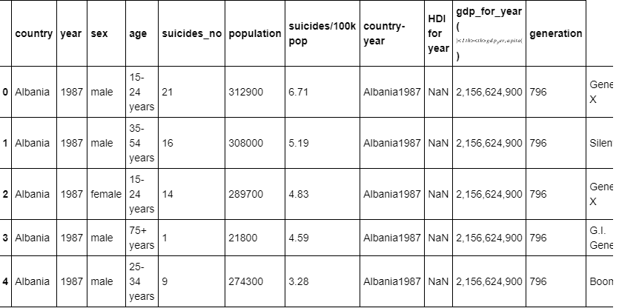
About Data
WHO has created this data over the years to see any kind of pattern among people who commit suicides
The Data has been cleaned and processed is ready to be used for Exploratory data analysis.

Slide 4
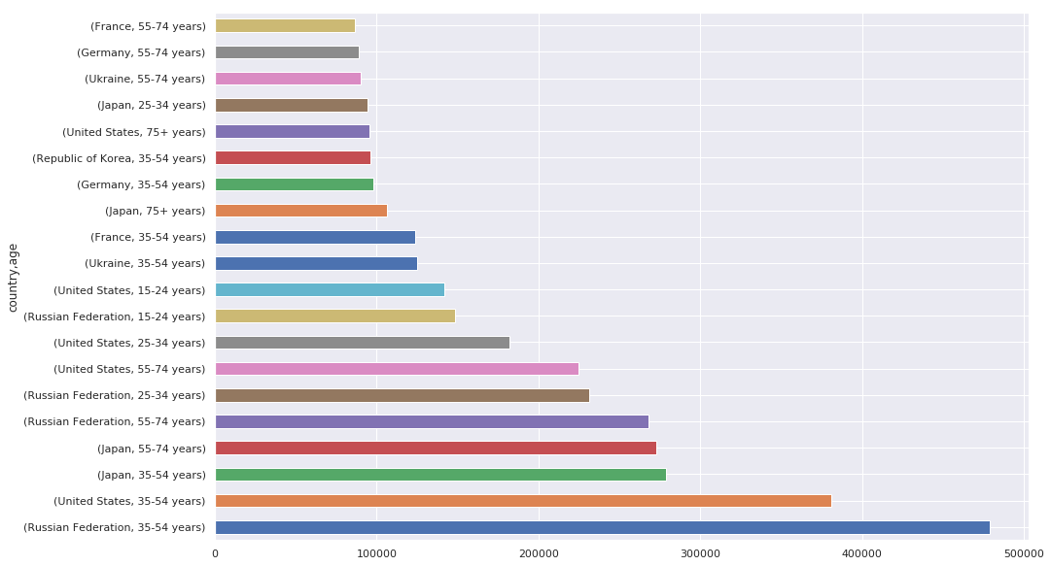
This graph can contain every age group for every country. This helps us find that Russian Federation has maximum cases of suicides from age group 35-54 over the years.

Slide 5
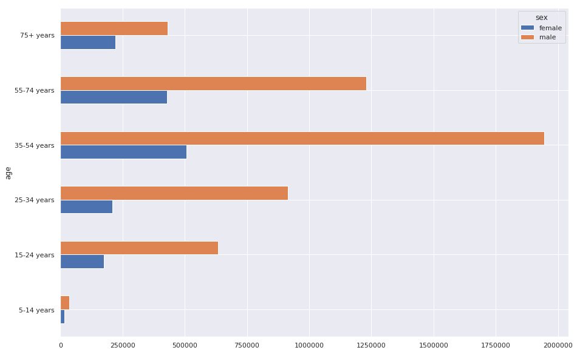
It is evident that people in their 30-50s are most stressed. As the graph suggests, The people from the age group 35-54 are more prone to suicides especially males.

Slide 6
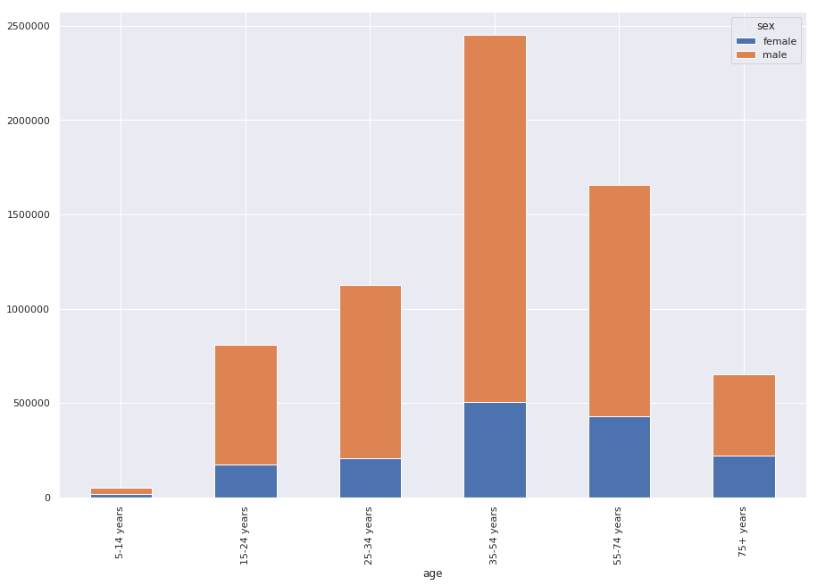
Here is stacked Bar Graph of number of suicide cases based on age groups. The graph suggests that males of age group 35-50 are more prone to suicides.

Slide 7
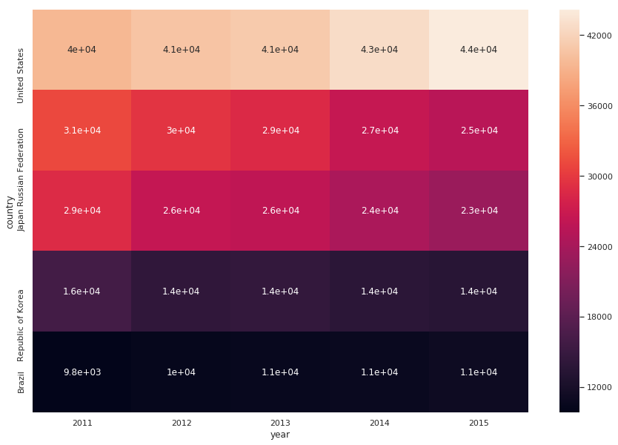
The graph here is the heatmap of suicidal cases in top 5 countries in recent years[ 2011, 2012, 2013, 2014, 2015 ]
United states has most cases of suicides in recent years and it is increasing every year. Rest of the top countries has decreasing number of suicides over these years which is a good thing. WHO needs to give special attention to its campaigns in USA

Slide 8
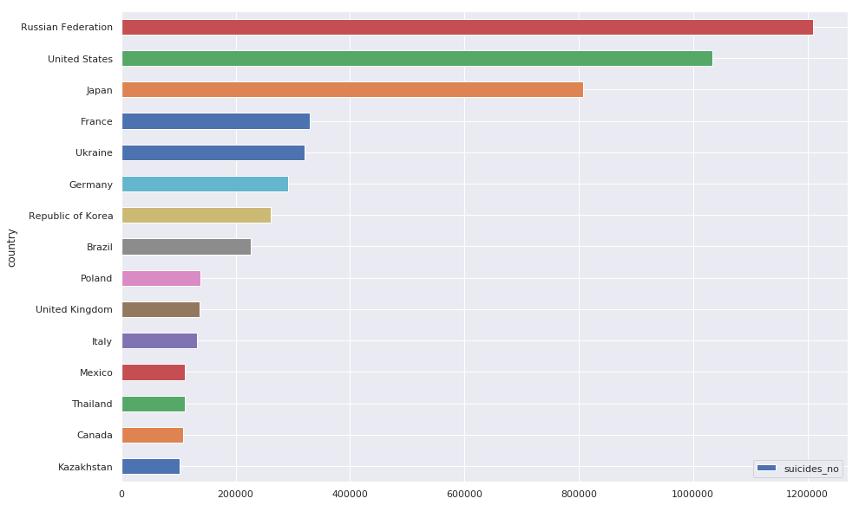
Russian Federation has maximum cases of suicides followed by USA. But from the previous graph we can say that USA has more suicides than Russian federation in recent years.

Slide 9
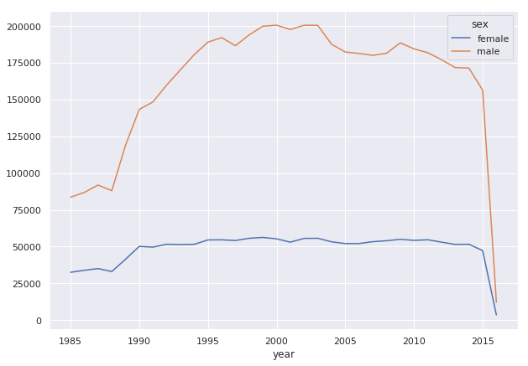
Number of suicides in females has been constant throughout the time period, whereas males have increasing number of cases.

Slide 10
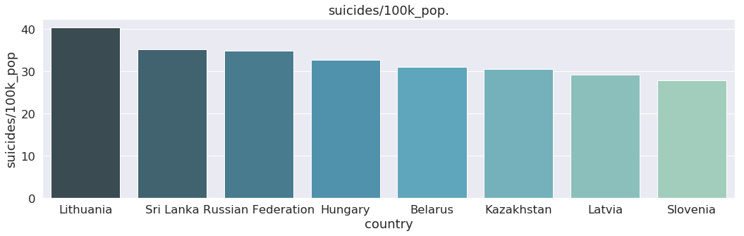
Lithuania has maximum suicides per 100k people followed by Sri Lanka. Most of the countries in the above graph has lesser population but they have more cases of suicides per 100k people. This is a key insight. These countries are not in top countries based on total suicides but the percentage of people committing suicides is higher.

Slide 11
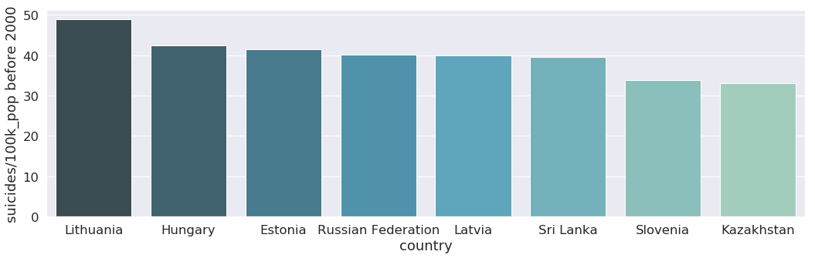
Lithuania was still at top before 2000.

Slide 12
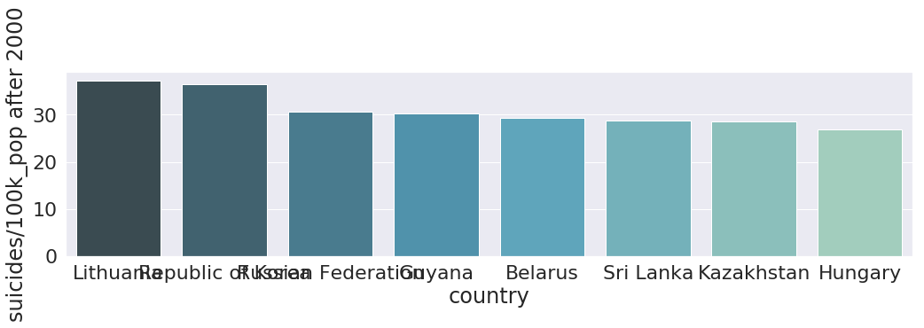
Not much has changed before and after 2000

Slide 13
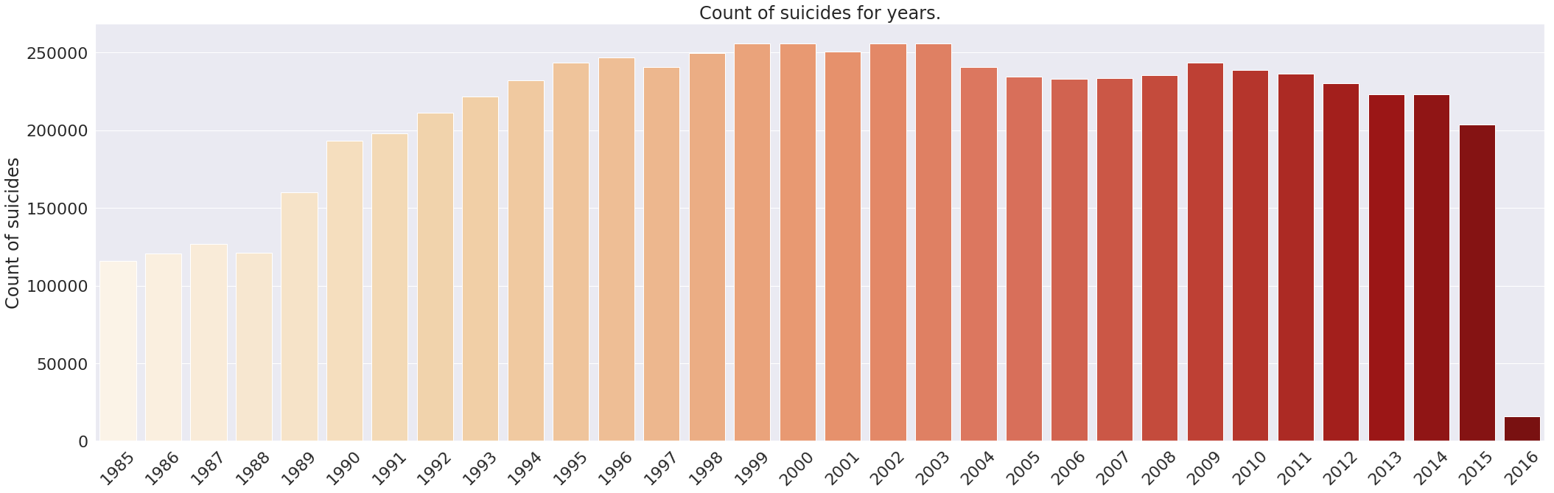
Suicides have been increasing over the years and has been constant for most of the years.

Slide 14
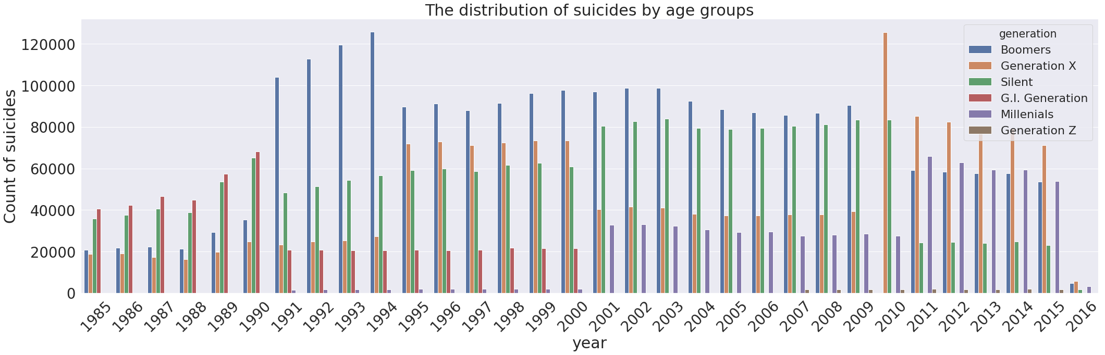
This graph serves a lot of insights. We can see that from 1985 to 1990 people from silent and G.I. generation had most suicide cases. From 1991 to 2009 Boomers were suiciding most. Now, In the recent years generation X has most cases of suicides.

Slide 15
The most prone age group for suicidal activities is 35-54 years age group. WHO should give special attention to people from that age group. Russian Federation has most cases of suicides over the entire period but US has experienced increasing number of suicide cases in the recent years. Although Russian Federation and US has most number of cases in these years. Lithuania and Sri Lanka has maximum percentage of people committing suicides. Males have more cases of suicide than females. In recent years, Boomers have been committing more suicides that any other age groups.

Slide 16

Thanks!
Contact us:
Your Company
123 Your Street
Your City, ST 12345
no_reply@example.com
www.example.com

